Slide 1
An Overview of Target and SIMD Directives and Clauses in open MP
By:
Nada Aladdin
Batool Kayyam
With:
Dr. Fady Ghanim

Slide 2
Overview of the Outline
Introduction to OpenMP
OpenMP Target
Clauses Used with Target
OMP Target Teams
OMP Target Teams Distribute
OMP Target Teams Distribute Parallel
OMP Target Teams Loop
OMP Declare Target
OMP SIMD
OMP Parallel For SIMD
Clauses Used with SIMD
OMP Declare SIMD
Summary
Conclusion

Slide 3
Introduction to OpenMP
OpenMP is a widely-used programming model for developing parallel applications on shared-memory systems, such as multi-core CPUs.
It provides a set of compiler directives and library functions that allow programmers to express parallelism in their code without the need for explicit thread management or synchronization.

Slide 4
Goal of this presentation
The goal of the presentation is to provide an overview of OpenMP target and SIMD directives and clauses, and how they can be used to accelerate heterogeneous computing.

Slide 5
OpenMP Target
#pragma omp target [clause[ [,] clause] ... ] new-line
OpenMP Target is a feature in OpenMP that allows you to offload computation to a separate device, such as a GPU. This can help improve performance by offloading compute-intensive tasks to more specialized hardware. We'll discuss the syntax in next slide.

Slide 6
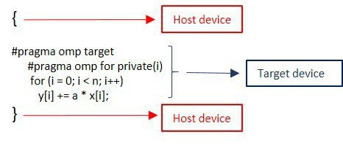
OpenMP Target – (cont.)

Slide 7
OpenMP Target – (cont.)
Host memory
Device memory
#pragma omp target
{
} // end of target
A: 000001110101010100101010101010101010101010100010101010

Slide 8
OpenMP Target – (cont.)
Host memory
Device memory
#pragma omp target
{
} // end of target
A: 000001110101010100101010101010101010101010100010101010
A:
alloc

Slide 9
OpenMP Target – (cont.)
Host memory
Device memory
#pragma omp target
{
} // end of target
A: 000001110101010100101010101010101010101010100010101010
A: 000001110101010100101010101010101010101010100010101010
map ( to:A)

Slide 10
OpenMP Target – (cont.)
Host memory
Device memory
#pragma omp target
{
} // end of target
A: 000001110101010100101010101010101010101010100010101010
A: 000001110101010100101010101010101010101010100010101010
Computation and update the data

Slide 11
OpenMP Target – (cont.)
Host memory
Device memory
#pragma omp target
{
} // end of target
A: 000001110101010100101010101010101010101010100010101010
A: 000001110101010100101010101010101010101010100010101010
Map from:
To get the data back from the device and it is moved over to the original storge

Slide 12
OpenMP Target – (cont.)
Host memory
Device memory
#pragma omp target
{
} // end of target
A: 000001110101010100101010101010101010101010100010101010
When we reached the end of the target the open MP will clean up the device memory

Slide 13
OpenMP Target – (cont.) map clause
The target map clause is used to explicitly control the data movement between the host and target devices. It ensures that the necessary data is available on the target device before executing the code enclosed within the target directive.
int a = 10, b = 20, c;
#pragma omp target map(from:c) map(to: a,b) {
c = a + b;
} // end of target
The variable a and b are mapped from the host to the target device with the to modifier The variable c is mapped from the target device to the host with the from modifier

Slide 14
OpenMP Target – (cont.) map clause
The target map clause is used to explicitly control the data movement between the host and target devices. It ensures that the necessary data is available on the target device before executing the code enclosed within the target directive.
The code within the target region performs the addition of a and b and stores the result in c on the target device. The modified value of c is then copied back to the host, and the result is printed.
int a = 10, b = 20, c;
#pragma omp target map(from:c) map(to: a,b) {
c = a + b;
} // end of target

Slide 15
Clauses Used with Target
Clause | Syntax | How it works
if | #pragma omp target if(condition) { // Code executed on the target device } | is used to conditionally execute the omp target directive based on a scalar expression. The directive is executed only if the expression evaluates to a true value.
Device | #pragma omp target device(device_id) { // Code executed on the specified target device } | is used to specify the target device for executing the omp target directive. It allows you to explicitly select a specific target device based on an integer expression.
private | #pragma omp target private(shared_var) { shared_var = omp_get_thread_num(); // Each thread on the target device modifies its private copy } | it used to declare variables that should have private copies on each target device. Each thread running on the target device has its own independent copy of the variable.

Slide 16
Clauses Used with Target
Clause | Syntax | How it works
firstprivate | #pragma omp target firstprivate(shared_var, private_var) { private_var = shared_var + omp_get_thread_num(); // Each thread on the target device modifies its private copy } | the certain variables should be private on the target device and initialized with the values from the enclosing context.
in_reduction | #pragma omp target { #pragma omp parallel reduction(+: sum) { #pragma omp for for (int i = 0; i < 10; i++) { sum += i; } } } | is used to specify reduction operations on variables within a target construct. It allows you to perform reductions on variables and accumulate the results across multiple threads running on the target device.

Slide 17
OMP Target Teams
The OMP Target Teams allows you to create teams of threads that can execute in parallel on separate devices. This can be useful when you have multi-core GPU and want to distribute work among them.
#pragma omp target teams [clause[,clause]]
specifies the number of teams to create, where each team consists of one or more thread
num_teams
thread_limit
specifies the maximum number of threads per team.

Slide 18
OMP Target Teams Distribute
#pragma omp target teams distribute [clause[ [,] clause] ... ] new-line
OMP Target Teams Distribute is a directive in OpenMP that extends the functionality of the OMP Target Teams directive by distributing loop iterations across the teams of threads on the target devices.
#pragma omp target teams distribute map(to:a[0:N][0:M],b[0:N][0:M]) map(from:c[0:N][0:M])
for (int i = 0; i < N; i++) {
#pragma omp distribute parallel for
for (int j = 0; j < M; j++) {
c[i][j] = a[i][j] + b[i][j];
}
}
#pragma omp target teams distribute
directive is used to distribute the outer loop iterations across the teams of threads on the target

Slide 19
OMP Target Teams Distribute Parallel
#pragma omp target teams distribute parallel
OMP Target Teams Distribute Parallel directive distributes the loop iterations across the teams of threads and executes them in parallel on each team. The parallel clause is used to parallelize the loop on each team.
#pragma omp target teams distribute parallel map(to:x[0:sz]) map(tofrom:y[0:sz]) for (int i = 0; i < sz; i++) { y[i] = a * x[i] + y[i];
the loop iterations are distributed across the teams of threads on the target device using the #pragma omp target teams distribute parallel directive. each team executes a subset of the loop iterations in parallel, using the parallel clause

Slide 20
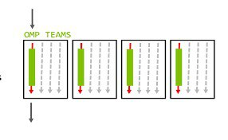
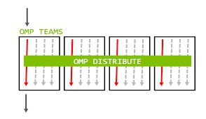
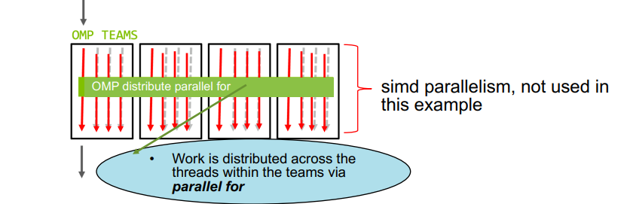

Slide 21
#pragma omp target teams distribute parallel for
Inter-block parallelism
Alert compiler to OpenMP
Intra-block parallelism
Execute on a device

Slide 22
OMP Target Teams Loop
#pragma omp target teams loop [clause[ [,] clause] ... ] new-line
the loop will be parallelized across multiple teams of threads, and each team will execute a portion of the loop iterations.
#pragma omp target teams loop
for (int i = 0; i < 10; i++) {
// Loop body
}

Slide 23
OMP Declare Target
Creates a device-specific version of a function that can be called from a target region. Any of the declared functions that appear between the omp declare target pragma statement can be used inside a target region that executes on the device.
#pragma omp declare target
int FirstFunction(int a);
int SecondFunction(int a);
#pragma omp end declare target
...
#pragma omp target {
...
x = FirstFunction(a) * SecondFunction(a);
...
}

Slide 24
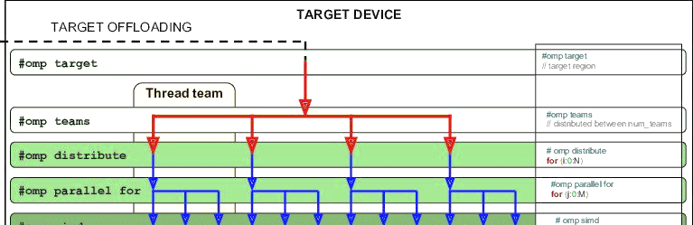

Slide 25
Any question about target directive ?

Slide 26
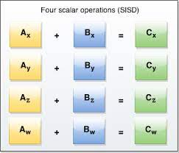
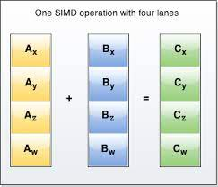
OpenMP SIMD
SIMD (Single Instruction Multiple Data) is a parallel processing technique that allows a single instruction to be executed on multiple data elements simultaneously.

Slide 27
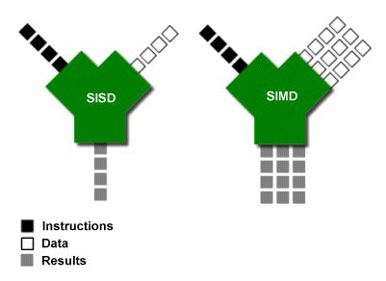
OpenMP SIMD –(cont.)

Slide 28
OpenMP SIMD –(cont.)
#pragma omp simd [clause[ [,] clause] ... ] new-line
for-loops
This directive in OpenMP is used to enable vectorization of loops, allowing for efficient execution of loop iterations using SIMD (Single Instruction, Multiple Data) instructions.

Slide 29
OpenMP SIMD –(cont.)
#pragma omp simd
for (int i = 0; i < n; i++) {
c[i] = a[i] + b[i];
}
omp simd directive to vectorize a loop. In this example (adding vectors) The omp simd directive instructs the compiler to generate SIMD instructions for the loop

Slide 30
OMP Parallel For SIMD
#pragma omp parallel for simd [clause[[,] clause] ...]
This directive combines the benefits of parallelization and vectorization, allowing multiple loop iterations to be executed in parallel on different data elements.
#pragma omp parallel for simd
for (int i = 0; i < n; i++) {
c[i] = a[i] + b[i];
}
The parallel for simd directive parallelizes the loop and executes multiple iterations in parallel on different data elements using SIMD instructions.

Slide 31
Clauses Used with SIMD safelen clause
safelen clause:
indicates that the loop iterations can be safely executed in parallel using SIMD, assuming a maximum of 4 consecutive iterations. This provides a hint to the compiler about the vectorization feasibility and safety
#pragma omp simd safelen(4)
for (int i = 0; i < N; i++) {
// Loop body
result[i] = array[i] + scalar;
}
The safelen(4) clause specifies that up to 4 consecutive iterations of the loop can be safely executed in parallel using SIMD instructions.

Slide 32
Clauses Used with SIMD uniform clause
Uniform:
clause is used to indicate that a variable used in the loop has a constant value across all iterations of the loop.
#pragma omp simd uniform(scalar)
for (int i = 0; i < N; i++) {
c[i] = a[i] + b[i] + scalar;
}
We inform the compiler that the value of scalar is the same for all loop iterations

Slide 33
Clauses Used with SIMD collapse clause
collapse(n):
specifies how many nested loops should be collapsed into a single loop.
#pragma omp simd collapse(2)
for (int i = 0; i < N; i++) {
for (int j = 0; j < N; j++) {
double sum = 0.0;
#pragma omp simd
for (int k = 0; k < N; k++) {
sum += a[i][k] * b[k][j];
}
c[i][j] = sum;
}
}
Multiplies two square matrices a and b of size N and stores the result in another matrix c.
The collapse(2) clause collapses the two outer loops into a single loop for parallelization,

Slide 34
Clauses Used with SIMD
Clause | Syntax | How it works
simdlen | #pragma omp simd simdlen(value) for (int i = 0; i < n; i++) { // Loop body } | is used to specify the preferred vector length or number of SIMD lanes to be used for vectorization. It allows you to provide a hint to the compiler about the desired SIMD vector length.
linear | #pragma omp simd linear(i:1) for (int i = 0; i < n; i++) { y[i] = a * x[i] + b * i; } | is a clause used to indicate that a variable in the loop will have a linear relationship with the loop index. This qualifier provides additional information to the compiler about the data access pattern of the variable
aligned | #pragma omp simd aligned(x: 32) aligned(y: 32) for (int i = 0; i < n; i++) { y[i] = x[i] + scalar; } | is used to specify that the arrays x and y should be aligned to a 32-byte boundary.
order | #pragma omp simd order(concurrent) for (int i = 0; i < n; i++) { // Loop body } | is used to specify that the loop iterations must be executed in a specific order. This can be useful when the loop contains dependencies between iterations, and the order of execution must be controlled to ensure correct results.

Slide 35
OMP Declare SIMD
#pragma omp declare simd [clause][[,]clause] ...]
Creates a version of a function that can process multiple arguments using Single Instruction Multiple Data (SIMD) instructions from a single invocation from a SIMD loop.

Slide 36
OMP Declare SIMD-(cont.)
We are telling the compiler that a specific function can be safely executed using SIMD instructions. The compiler can then use this information to generate SIMD instructions for loops that call the function.
#pragma omp declare simd double myfunc(double x, double y);
….
….
….
#pragma omp simd for (int i = 0; i < N; i++) { result[i] = myfunc(array[i], scalar); }

Slide 37
Summary
OpenMP Target is an OpenMP directive used to offload parallel computations to an accelerator device, such as a GPU.
We have also discussed the various OpenMP directives that can be used with the Target directive, including target teams, target teams distribute, target teams distribute parallel, and target teams loop. These directives allow developers to target specific parallel constructs.
Additionally, we have discussed the declare target and declare simd directives, which allow developers to specify functions that can be offloaded to an accelerator device or executed using SIMD instructions, respectively.
Finally, we have covered the parallel for simd directive and the clauses that can be used with it, such as safelen, linear, and aligned. This directive enables developers to execute loops using SIMD instructions, potentially improving performance.

Slide 38
Conclusion
OpenMP provides a rich set of directives and clauses that enable developers to target parallelism in their programs, offload computations to accelerator devices, and execute loops using SIMD instructions. By using these features effectively, developers can write highly efficient parallel programs for shared-memory architectures.

Slide 39
Thank you..

